Slide 1
COVID-19 OWID testing data
Major Project : Data Science Batch May

Slide 2

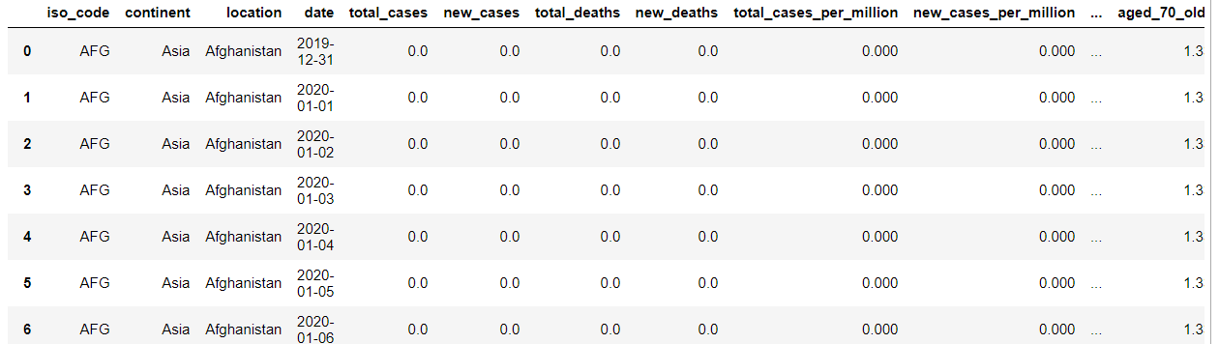
Loading the Dataset:

Slide 3

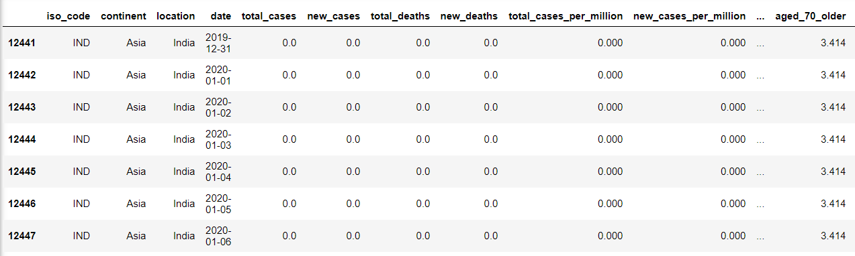
Subsetting the dataset to get the data of India

Slide 4
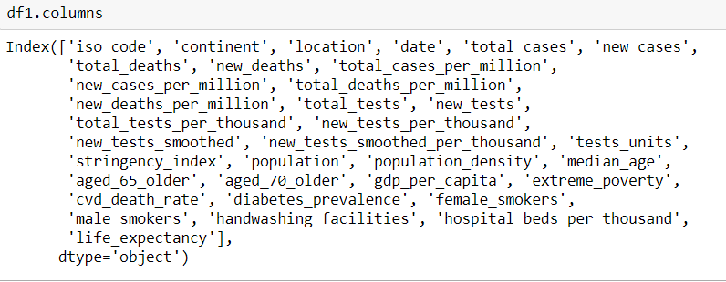

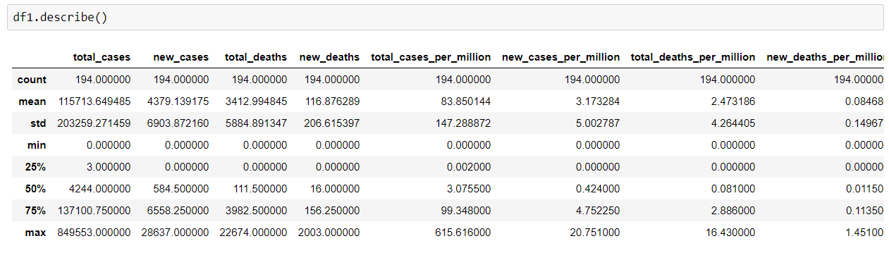
About the dataset

Slide 5
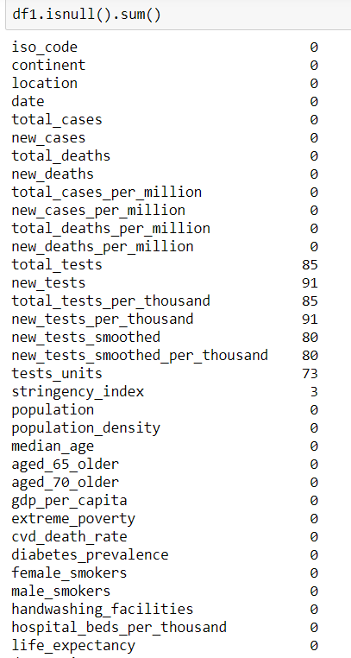
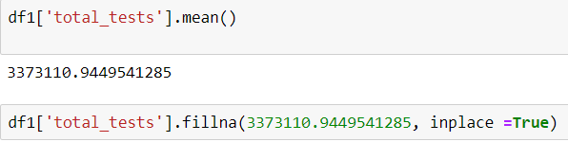
Handling Null Values
Replacing the null values in numerical data by mean.
Replacing the null values in categorical data by mode.
Dropping the columns in which more than 50% values are null.

Slide 6
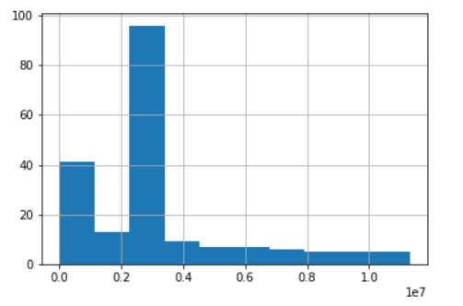
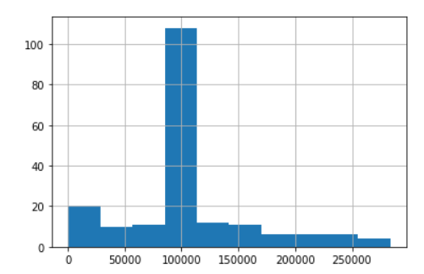
Univariate Analysis
Total Number of Tests
Total Number of New Tests
The above graph suggests that it took us 42 days to reach the total test count to 10^6.
It took around 20 days for the new_tests to reach 25000.

Slide 7
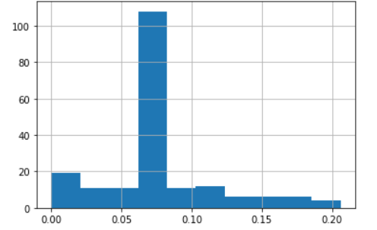
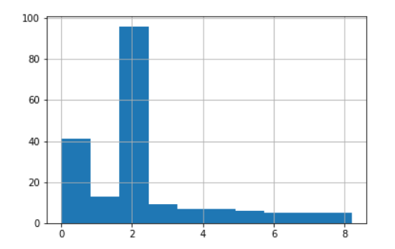
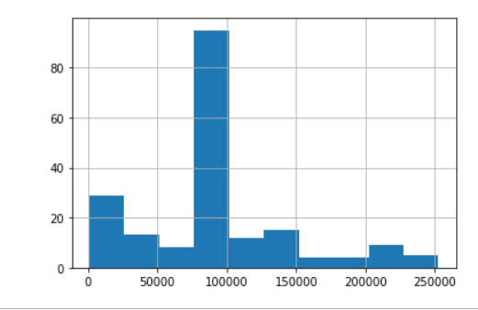
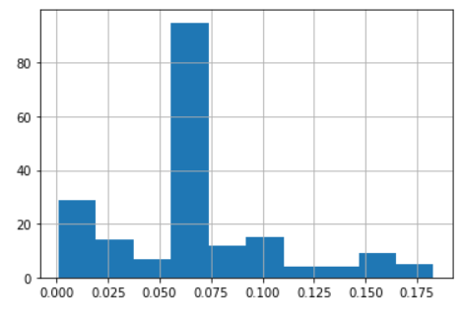
Total number of New Tests per Thousand
Total Number of Tests per Thousand
Number of New Tests smoothed
Number of New Tests smoothed per Thousand
It took around 30 days for the new_tests_smoothed to reach 25000.

Slide 8
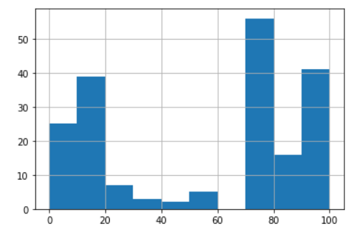
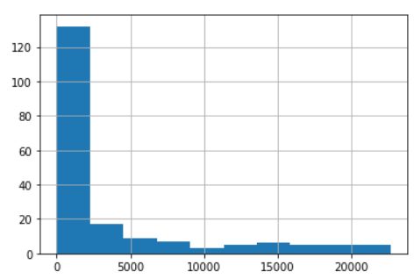
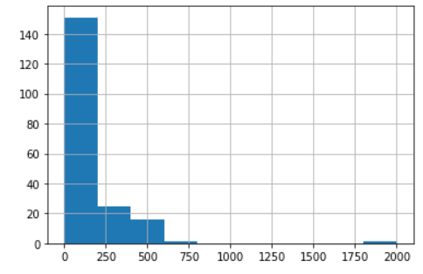
Stringency Index
Total Deaths
It took around 25 days for the stringency index to reach 10.
New Deaths
It took around 134 days for the total_deaths to reach 2500.
It took about 145 days for the new deaths to reach 240.

Slide 9
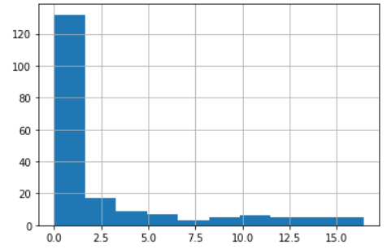
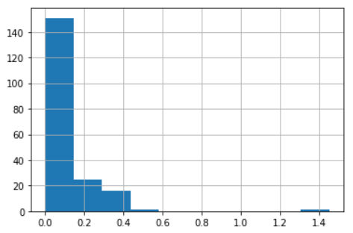
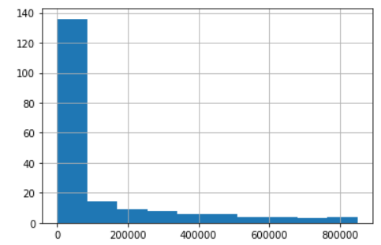
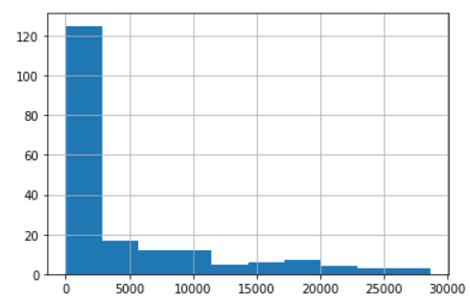
Total deaths per million
New deaths per million
Total cases
It took around 138 days for total cases to reach 100000.
New cases
It took around 122 days for new cases to reach 2500.

Slide 10
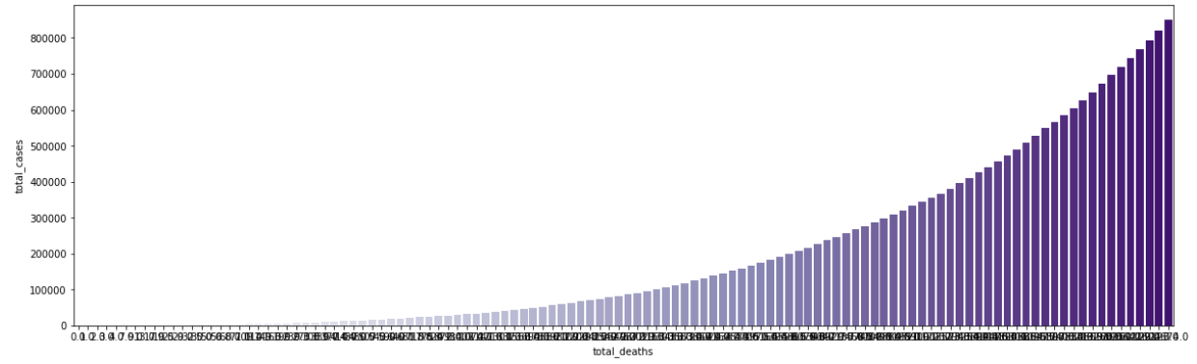
Bivariate Analysis
In bivariate analysis we plot the total cases with the rest of the feature columns to get an idea about the trend of the target column with the rest of the features.
Total Cases Vs Total Deaths : As one might expect the total number of deaths is steadily increasing with the total number of cases.

Slide 11
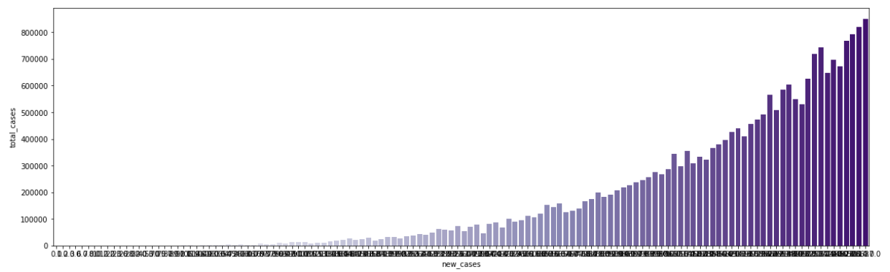
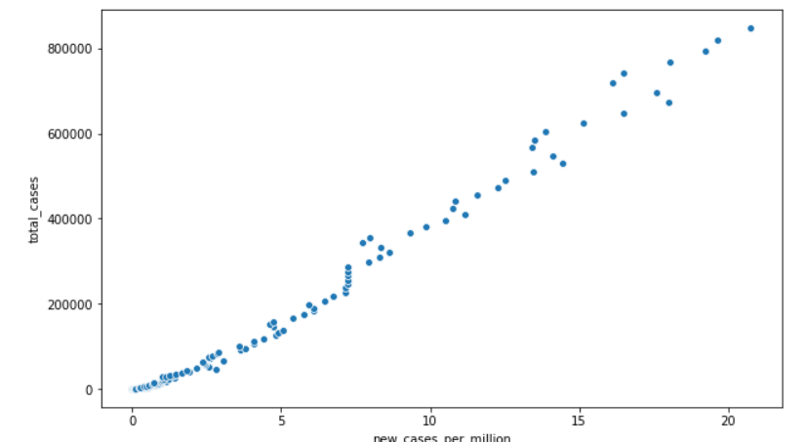
Total Cases VS New Cases : For the above graph with new_cases VS total_cases the trend is increasing only but on certain days the new cases on the day before is more than the day after. It is not strictly increasing like that of total deaths.

Slide 12
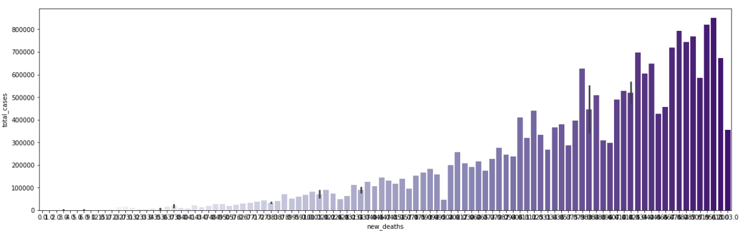
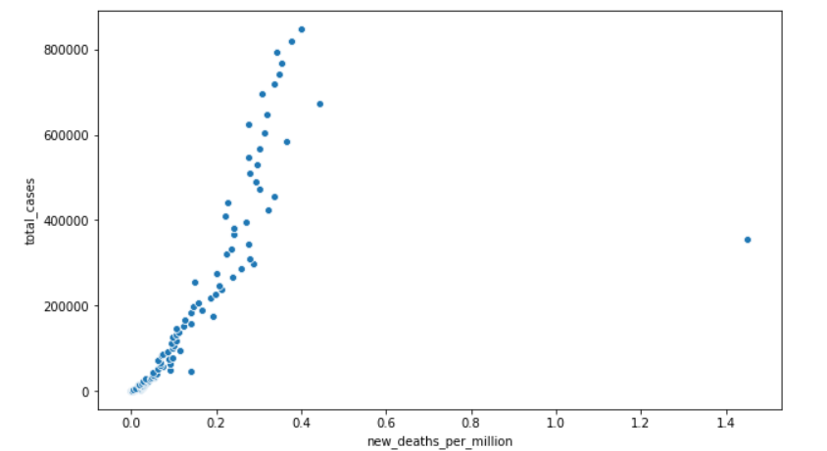
Total Cases VS New Deaths :In comparison to the graph of new cases, the new deaths is increasing but not in the same ratio as that of the new cases, which means the death rate of India is very less in relation with the number of new cases we are getting everyday.

Slide 13
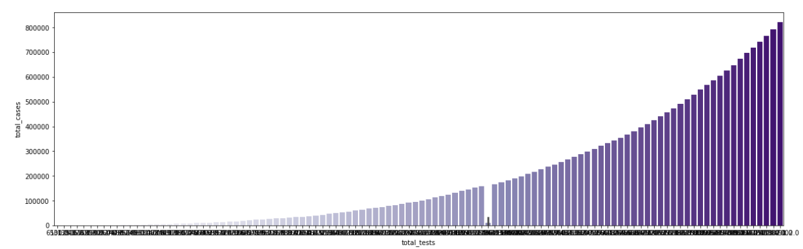
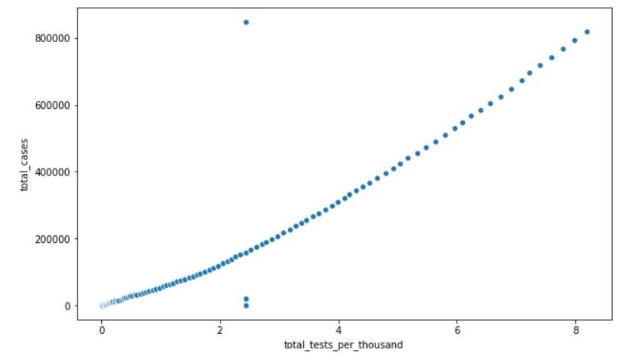
Total Cases VS Total Tests : The total number of tests is rapidly increasing with the increase of total number of cases.

Slide 14
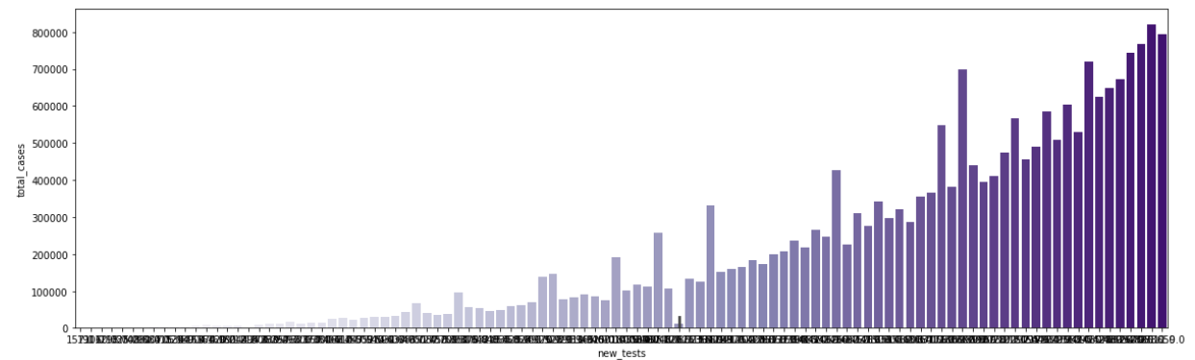
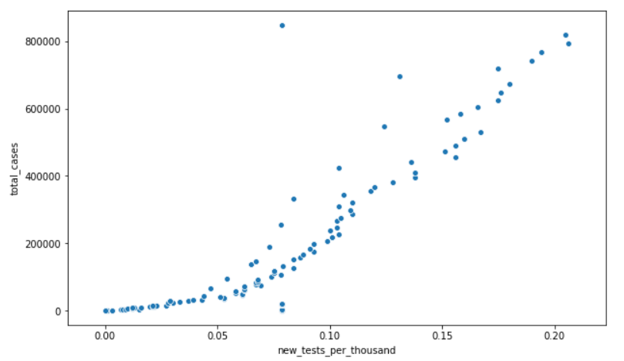
Total Cases VS New Tests : New tests also has a rising trend but with certain irregularities , on particular days the new tests are more on the previous day.

Slide 15
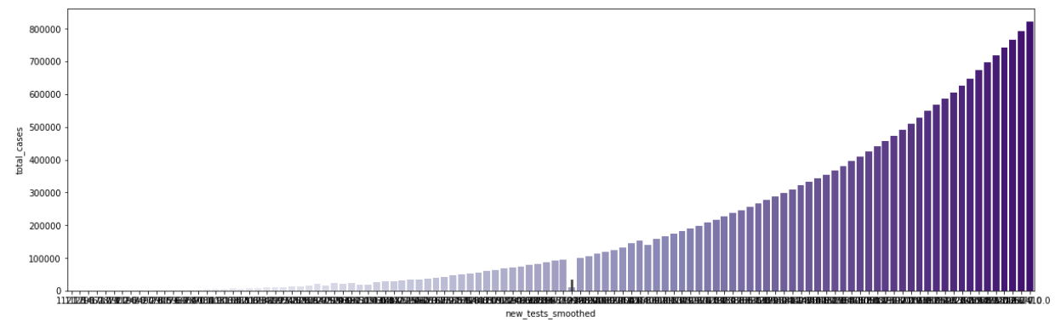
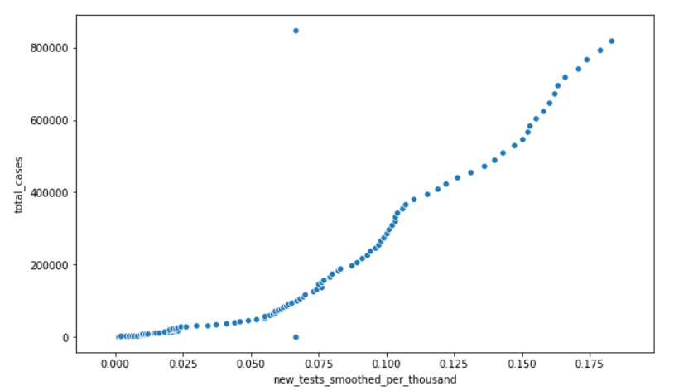
Total Cases Vs New Tests smoothed : New tests smoothed is increasingly steadily with the increase in total number of cases.

Slide 16
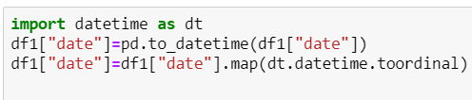

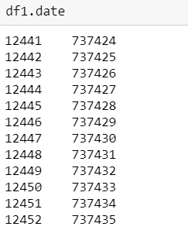
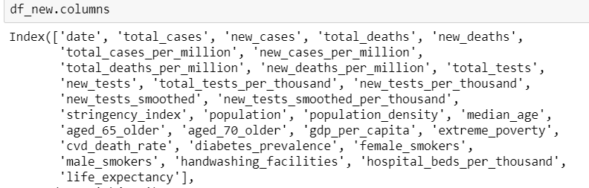
Converting Date to Ordinal and Dropping Categorical columns

Slide 17

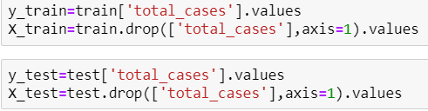
Splitting into test-train

Slide 18
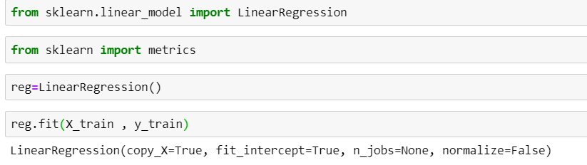
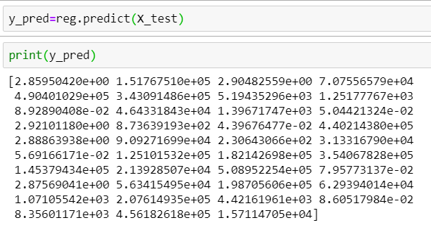
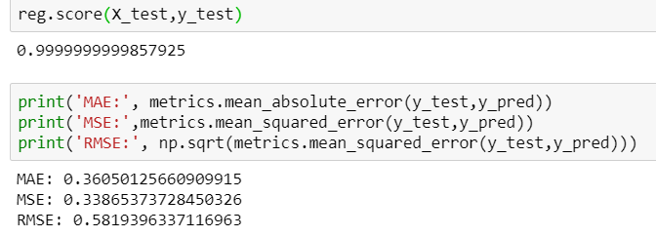
Linear Regression Model

Slide 19
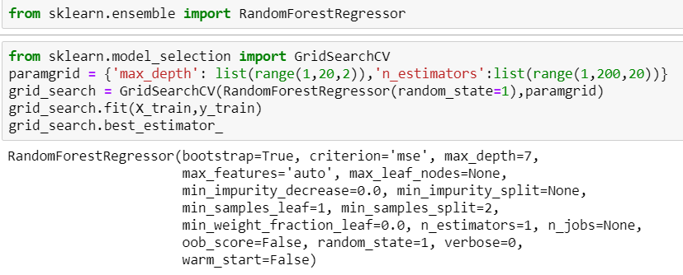
Random Forest Model
Implemented Grid Search CV to obtain optimal parameters of the model :

Slide 20
